Slide 1
Week 8:
Descriptive Statistics
Research Methods for IT

Slide 2
Workshop expectations
Before the workshop:
Watch the week’s videos, read the associated work. Complete the weekly quiz on Moodle in preparation for the workshop (5% of your overall mark).
Tips:
Plan how to use the weekly materials before each workshop
Space out studying periods during the week
During the weekly 2-hour workshop:
3 activities:
Work in small groups of 3-4 students on each activity
Record your work on shared worksheet and share your group’s work with the rest of the workshop.
Before the end of the week:
Complete your contribution statement as part of your weekly consolidation activity (5% of your overall mark)

Slide 3

Describing Data
Measure central tendency, spread and dispersion

Slide 4
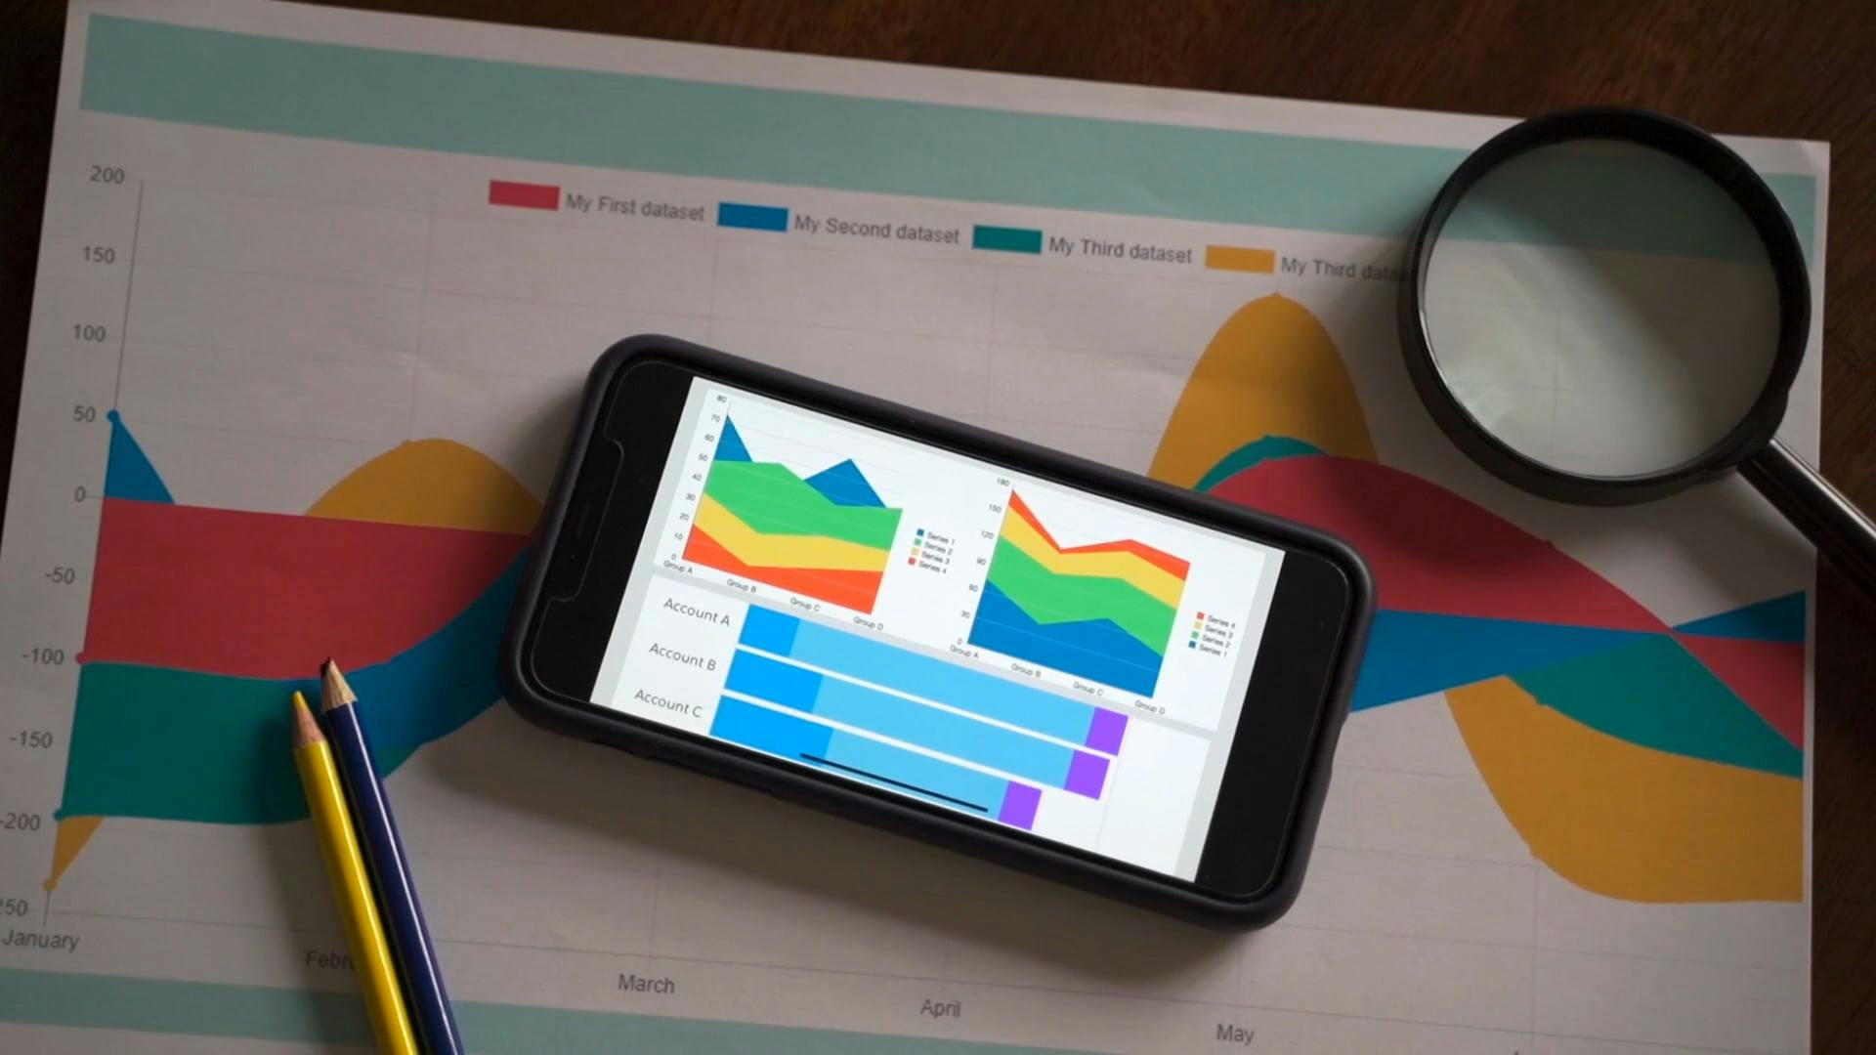
Visualising Data
Create graphs and charts to make sense of data

Slide 5

Telling a Data Story
Explain trends in your data with narratives

Slide 6
Activity 1: Describing Data (Part A, 25 min)
Consider the dataset on Moodle (under Week 8)
Measures of central tendency:
Calculate measures of central tendency for each of the 11 concerns (across all the countries) using Google Spreadsheets:
Mean and median for the % of the respondents
Compare the results and discuss what they reveal about people’s opinions on different concerns
For which concerns are the mean and median close to each other?
For which concerns are the mean and median far apart?
What does this tell us about the skewness of the distribution of the responses relative to each concern?

Slide 7
Activity 1: Describing Data (Part B, 25 min)
Measures of spread and dispersion:
Calculate measures of spread and dispersion in each concern using Google Spreadsheets:
STD, Range and Inter-Quartile Range (IQR) for the the % of the respondents
Discuss what these measures reveal about the spread of the data.
Are there any outliers in the data?
If so, how do they affect the range and IQR?
What does this tell us about the variability of the responses regarding each concern?

Slide 8
Activity 2: Data Visualisation (25 min)
Consider the dataset on Moodle
What type of chart/graph would you use to represent your data?
Create 2 types of charts/graphs of your choice to visualise % of responses in Australia, Italy, Kenya and Mexico (pivot table for the visuals is available in the spreadsheets)
You can visualise trends based on the following concerns: Impact of AI on education, Impact of AI on jobs, My own ability to use AI and Violation of citizens privacy
Use different colours/chart columns for each country to make the charts/graphs visually appealing
Make sure the plots are fully annotated and accessible
Discuss what the charts/graphs reveal about different concerns people in the four countries expressed regarding AI.

Slide 9
Activity 3: Telling a Data Story (25 min)
Consider the dataset on Moodle:
What insight could you draw from the dataset?
Create a narrative that compares AI concerns in Australia, Italy, Kenya and Mexico by describing the differences between the four countries in terms of the responses.
Use the statistics and visuals from the previous 2 activities to support your narrative.
Choose and define who your audience will be

Slide 10
Activity 3: Telling a Data Story
3. Discuss what the data could possibly reveal about the cultural, economic, or social factors that might influence similarities/differences across different concerns in each of the four countries.
4. Present the story using one of the following:
Sketch or illustration
Rap
News-cast
Magazine Article
5. You will have 2 minutes to deliver your narrative to your classmates

Slide 11

What is one thing that worked well in today’s and previous week's class?
What is one area where you think there could be improvement?
The responses are completely anonymous.

